Slide 1
Chapter 4
Normalization of Database Tables

Slide 2
In this chapter, you will learn:
What normalization is and what role it plays in database design
About the normal forms 1NF, 2NF, 3NF, BCNF, and 4NF
How normal forms can be transformed from lower normal forms to higher normal forms
That normalization and E-R modeling are used concurrently to produce a good database design
That some situations require de-normalization to generate information efficiently

Slide 3
Database Tables and Normalization
Table is basic building block in database design
Table’s structure is of great interest
Two cases:
possible poor table structures in good database design
Modify existing database with existing poor table structure
Normalization can help recognize a poor table and convert to good tables with good structure

Slide 4
Database Tables and Normalization
Normalization is process for assigning attributes to entities
Reduces data redundancies
Expending entities
Helps eliminate data anomalies
Produces controlled redundancies to link tables
Cost more processing efforts
Series steps called normal forms

Slide 5
Database Tables and Normalization
Normalization stages
1NF - First normal form
2NF - Second normal form
3NF - Third normal form
4NF - Fourth normal form
Business
Bioinformatics
Statistical data
Worse in performance (I/O)
Better in dependency

Slide 6
Database Tables and Normalization
Example: construction company
Building projects
Project number
Project name
Employees assigned
…
Employee
Employee number
Employee name
Job classification

Slide 7
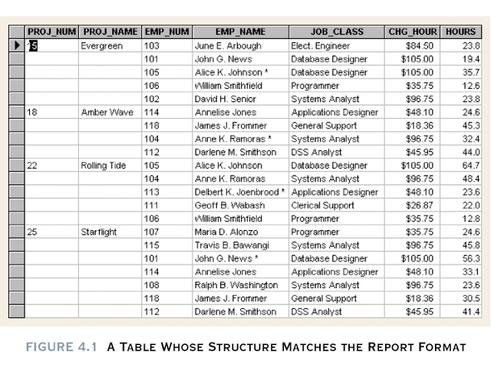
Table 4.1 should be here.

Slide 8
Figure 4.1 Observations
PRO_NUM intended to be primary key, but it contains null values.
Table entries invite data inconsistencies

Slide 9
Figure 4.1 Observations
Table displays data redundancies which yield the following anomalies
Update
Modifying JOB_CLASS
Insertion
New employee must be assigned project (phantom project)
Deletion
If employee deleted, other vital data lost

Slide 10
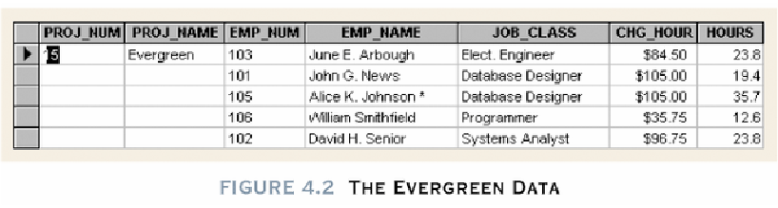
Figure 4.2 is insert here.
Repeating group (any project can have a group of data entries) which should not to be appeared in relational table

Slide 11
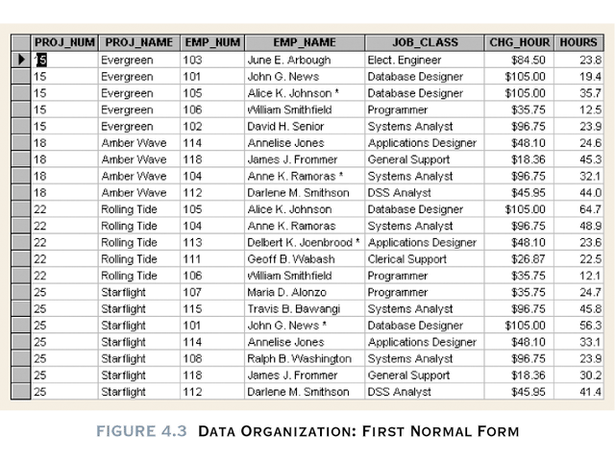
Data Organization: 1NF
PK
PK
Figure 4.3

Slide 12
Conversion to 1NF
Repeating groups must be eliminated
Proper primary key developed
Uniquely identifies attribute values (rows)
Combination of PROJ_NUM and EMP_NUM

Slide 13
Conversion to 1NF
Repeating groups must be eliminated
Dependencies can be identified
A particular relationship between two attributes. For a given relation, attribute B is functionally dependent on attribute A if, for every valid value of A, that value of A uniquely determines the value of B.
A functional dependency exists when the value of one thing is fully determined by another. For example, given the relation EMP(empNo, empName, sal), attribute empName is functionally dependant on attribute empNo. If we know empNo, we also know the empName.

Slide 14
Desirable dependencies based on primary key Less desirable dependencies Partial based on part of composite primary key Transitive one nonprime attribute depends on another nonprime attribute

Slide 15
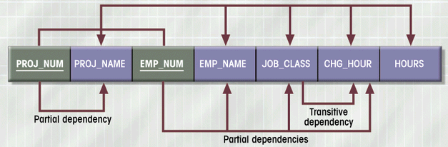
Dependency Diagram (1NF)
Above: Desired Dependencies
Composite primary key
Figure 4.4
Below: Less Desired Dependencies

Slide 16
PROJ_NUM,EMP_NUM → PROJ_NAME, EMP_NAME, JOB_CLASS,CHG_HOUR, HOURS
DESIRED DEPENDENCIES
PROJ_NUM → PROJ_NAME
PARTIAL DEPENDENCIES
EMP_NUM → EMP_NAME, JOB_CLASS, CHG_HOUR
JOB_CLASS -> CHG_HOUR
TRANSITIVE DEPENDENCIES

Slide 17
1NF Summarized
All key attributes defined
No repeating groups in table
All attributes dependent on
primary key

Slide 18
Conversion to 2NF
Start with 1NF format:
Write each key component on separate line
Write original key on last line
Each component is new table
Write dependent attributes after each key
PROJECT (PROJ_NUM, PROJ_NAME)
EMPLOYEE (EMP_NUM, EMP_NAME, JOB_CLASS, CHG_HOUR)
ASSIGN (PROJ_NUM, EMP_NUM, HOURS)

Slide 19
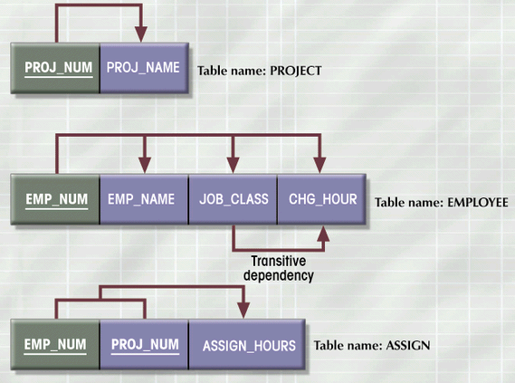
2NF Conversion Results
Figure 4.5

Slide 20
2NF Summarized
In 1NF
Includes no partial dependencies
No attribute dependent on a portion of primary key
Still possible to exhibit transitive dependency
Attributes may be functionally dependent on nonkey attributes

Slide 21
Conversion to 3NF
Create separate table(s) to eliminate transitive functional dependencies
PROJECT (PROJ_NUM, PROJ_NAME)
ASSIGN (PROJ_NUM, EMP_NUM, HOURS)
EMPLOYEE (EMP_NUM, EMP_NAME, JOB_CLASS)
JOB (JOB_CLASS, CHG_HOUR)

Slide 22
3NF Summarized
In 2NF
Contains no transitive dependencies

Slide 23
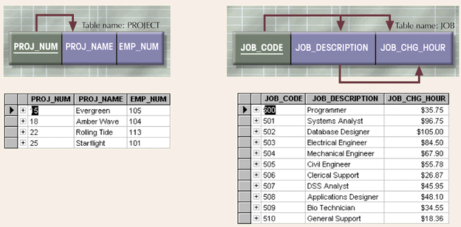
Additional DB Enhancements
Figure 4.6

Slide 24
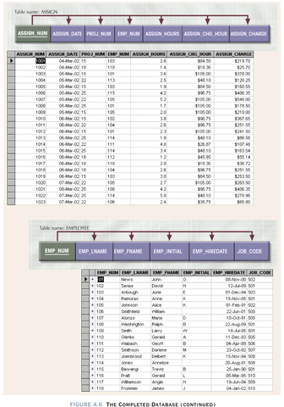

Slide 25
Boyce-Codd Normal Form (BCNF)
Every determinant in the table is a candidate key
Determinant is attribute whose value determines other values in row
3NF table with one candidate key is already in BCNF

Slide 26
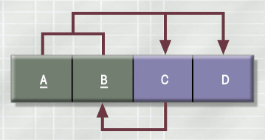
3NF Table Not in BCNF
Figure 4.7

Slide 27
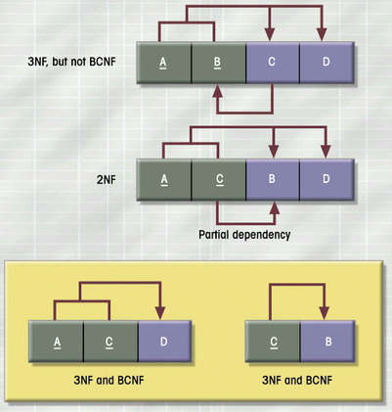
Decomposition of Table Structure to Meet BCNF
Figure 4.8

Slide 28
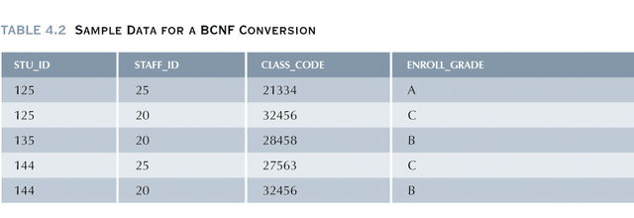
Example: BCNF conversion

Slide 29
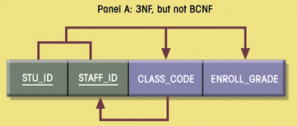
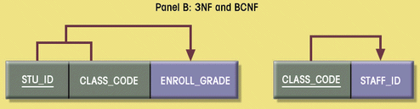
Decomposition into BCNF
Figure 4.9

Slide 30
Normalization and Database Design
Normalization should be part of the design process
Make sure the proposed entities meet the required normal form before the table structures are created
Used to redesign or modify the existing table structures.
E-R Diagram provides macro view

Slide 31
Normalization and Database Design
Normalization provides micro view of entities
Focuses on characteristics of specific entities
May yield additional entities
Difficult to separate normalization from E-R diagramming
Business rules must be determined

Slide 32
Normalization and Database Design
Contracting company’s example:
PROJECT (PROJ_NUM, PROJ_NAME)
EMPLOYEE(EMP_NUM, EMP_LNAME,EMP_FNAME,EMP_INITAL,
JOB_DESCRIPTION, JOB_CHG_HOUR);

Slide 33
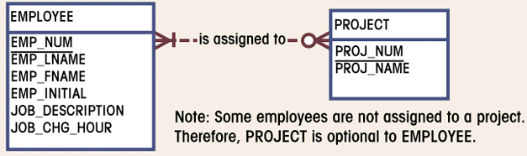
Initial ERD for Contracting Company
Figure 4.10
There is a transitive dependency
Already 3NF

Slide 34
Removal
PROJECT (PROJ_NUM, PROJ_NAME)
EMPLOYEE(EMP_NUM, EMP_LNAME,EMP_FNAME,EMP_INITAL,
JOB_CODE)
JOB (JOB_CODE, JOB_DESCRIPTION, JOB_CHG_HOUR);

Slide 35
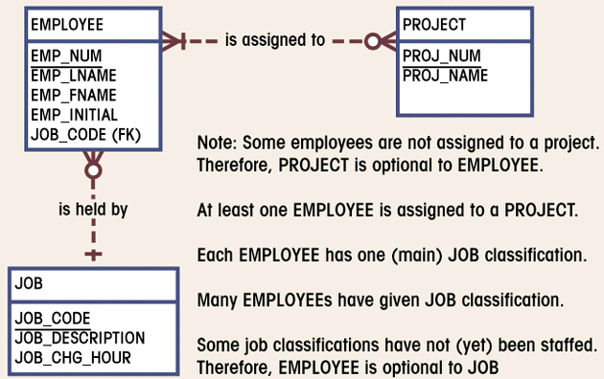
Modified ERD for Contracting Company
Figure 4.11

Slide 36
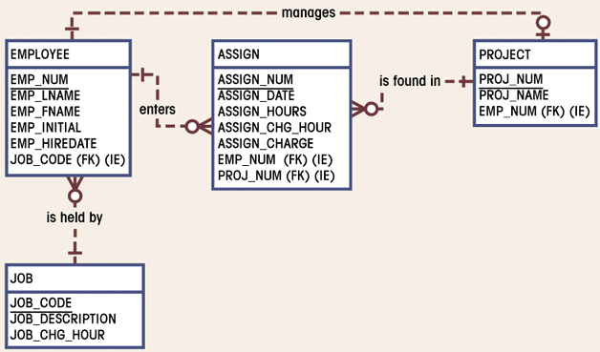
Final ERD for Contracting Company
Figure 4.12
(M:N) converting to (1:M)

Slide 37
PROJECT (PROJ_NUM, PROJ_NAME, EMP_NUM)
EMPLOYEE(EMP_NUM, EMP_LNAME,EMP_FNAME,EMP_INITAL,
EMP_HIREDATE, JOB_CODE)
JOB (JOB_CODE,, JOB_DESCRIPTION, JOB_CHG_HOUR);
ASSIGN((ASSIGN_NUM, ASSIGN_DATE, ASSIGN_HOURS,
ASSIGN_CHG_HOURS, ASSIGN_CHARGE, EMP_NUM, PROJ_JUM)

Slide 38
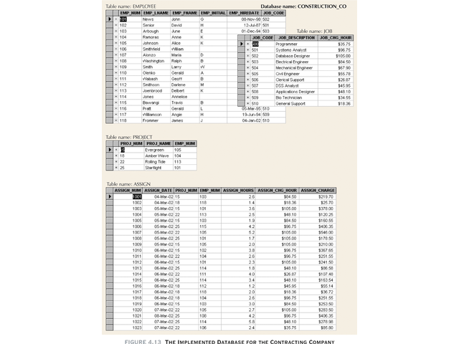

Slide 39
Denormalization
Normalization is one of many database design goals
Normalized table requirements
Additional processing
Loss of system speed

Slide 40
Denormalization
Normalization purity is difficult to sustain due to conflict in:
Design efficiency
Information requirements
Processing

